Slide 1

Functions
CS Bridge 2020

Slide 2

Learn How To:
Write a function that takes in input
Write a function that gives back output
Trace function calls using stacks

Slide 3
Lecture Plan
Functions: From Karel to Python
Example: Factorial
More About Functions
Example: Graphics

Slide 4
Lecture Plan
Functions: From Karel to Python
Example: Factorial
More About Functions
Example: Graphics

Slide 5
Calling functions
turn_right()
move()
input(“string please! ”)
print(“hello world”)
float(“0.42”)
math.sqrt(25)

Slide 6

Defining a function
def turn_right():
turn_left()
turn_left()
turn_left()
Big difference with python functions:
Python functions can take in data, and can return data!

Slide 7

Toasters are functions
For example:
main_toaster
- Thanks Mehran

Slide 8
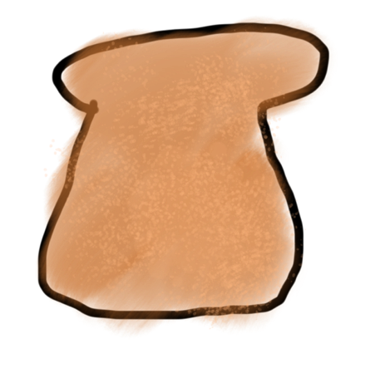
Toasters are functions
parameter

Slide 9

Toasters are functions
parameter

Slide 10
Toasters are functions

Slide 11

Toasters are functions

Slide 12
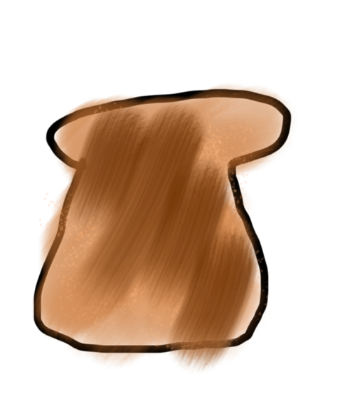
Toasters are functions
return

Slide 13
Toasters are functions

Slide 14

Toasters are functions
* You don’t need a second toaster if you want to toast bagels. Use the same one.

Slide 15
Toasters are functions

Slide 16

Toasters are functions

Slide 17
Toasters are functions

Slide 18
Toasters are functions

Slide 19
Toasters are functions

Slide 20
functions are Like Toasters

Slide 21

functions are Like Toasters

Slide 22
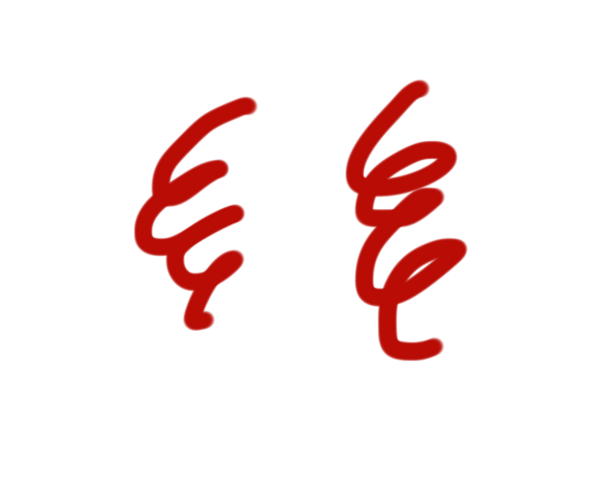
functions are Like Toasters

Slide 23
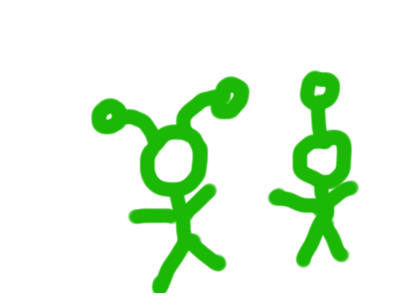
functions are Like Toasters

Slide 24
functions are Like Toasters
parameter(s)
return

Slide 25
Formally
def name_of_function(parameters):
statements
# optionally
return value
name: information passed into function
parameters: information passed into function
return: information given back from the function

Slide 26

Classic Challenge
Perhaps the most underrated concept by students

Slide 27
Anatomy of a function
def main():
mid = average(5.0, 10.2)
print(mid)
def average(a, b):
sum = a + b
return sum / 2

Slide 28
Anatomy of a function
def main():
mid = average(5.0, 10.2)
print(mid)
def average(a, b):
sum = a + b
return sum / 2
function “call”
function “definition”

Slide 29
Anatomy of a function
def main():
mid = average(5.0, 10.2)
print(mid)
def average(a, b):
sum = a + b
return sum / 2
name

Slide 30
Anatomy of a function
def main():
mid = average(5.0, 10.2)
print(mid)
def average(a, b):
sum = a + b
return sum / 2
Input given
Input expected

Slide 31
Anatomy of a function
def main():
mid = average(5.0, 10.2)
print(mid)
def average(a, b):
sum = a + b
return sum / 2
Arguments
Parameters

Slide 32
Anatomy of a function
def main():
mid = average(5.0, 10.2)
print(mid)
def average(a, b):
sum = a + b
return sum / 2
body

Slide 33
Anatomy of a function
def main():
mid = average(5.0, 10.2)
print(mid)
def average(a, b):
sum = a + b
return sum / 2
This call “evaluates” to the value returned
Ends the function and gives
back a value

Slide 34
Anatomy of a function
Also a function definition
def main():
mid = average(5.0, 10.2)
print(mid)
def average(a, b):
sum = a + b
return sum / 2

Slide 35
Anatomy of a function
No parameters (expects no input)
def main():
mid = average(5.0, 10.2)
print(mid)
def average(a, b):
sum = a + b
return sum / 2

Slide 36
Anatomy of a function
def main():
mid = average(5.0, 10.2)
print(mid)
def average(a, b):
sum = a + b
return sum / 2
When a function ends it “returns”

Slide 37
Parameters
Parameters let you provide a function some information when you are calling it.

Slide 38
Is returning
the same as printing?

Slide 39
Is returning
the same as printing?
NO

Slide 40

Learn by Example

Slide 41
Lecture Plan
Functions: From Karel to Python
no parameter, no return
parameter
parameter and return
Example: Factorial
More About Functions
Example: Graphics

Slide 42
No Parameter, No Return
def print_intro():
print("Welcome to class")
print("It's the best part of my day.")
terminal
> python3 intro.py
def main():
print_intro()

Slide 43
No Parameter, No Return
def print_intro():
print("Welcome to class")
print("It's the best part of my day.")
terminal
> python3 intro.py
def main():
print_intro()

Slide 44
No Parameter, No Return
def print_intro():
print("Welcome to class")
print("It's the best part of my day.")
terminal
> python3 intro.py
def main():
print_intro()

Slide 45
No Parameter, No Return
def print_intro():
print("Welcome to class")
print("It's the best part of my day.")
terminal
> python3 intro.py
def main():
print_intro()

Slide 46
No Parameter, No Return
def print_intro():
print("Welcome to class")
print("It's the best part of my day.")
terminal
> python3 intro.py
Welcome to class
def main():
print_intro()

Slide 47
No Parameter, No Return
def print_intro():
print("Welcome to class")
print("It's the best part of my day.")
terminal
> python3 intro.py
Welcome to class
It’s the best part of my day
def main():
print_intro()

Slide 48
No Parameter, No Return
def print_intro():
print("Welcome to class")
print("It's the best part of my day.")
terminal
> python3 intro.py
Welcome to class
It’s the best part of my day
def main():
print_intro()

Slide 49
No Parameter, No Return
def print_intro():
print("Welcome to class")
print("It's the best part of my day.")
terminal
> python3 intro.py
Welcome to class
It’s the best part of my day
def main():
print_intro()

Slide 50
No Parameter, No Return
def print_intro():
print("Welcome to class")
print("It's the best part of my day.")
terminal
> python3 intro.py
Welcome to class
It’s the best part of my day
def main():
print_intro()

Slide 51
Lecture Plan
Functions: From Karel to Python
no parameter, no return
parameter
parameter and return
Example: Factorial
More About Functions
Example: Graphics

Slide 52
Parameter Example
terminal
> python3 opinion.py
def print_opinion(num):
if(num == 5):
print(“I love 5!”)
else :
print(“Whatever”)
def main():
print_opinion(5)

Slide 53
Parameter Example
main memory
terminal
> python3 opinion.py
def print_opinion(num):
if(num == 5):
print(“I love 5!”)
else :
print(“Whatever”)
No variables
def main():
print_opinion(5)

Slide 54
Parameter Example
main memory
terminal
> python3 opinion.py
def print_opinion(num):
if(num == 5):
print(“I love 5!”)
else :
print(“Whatever”)
No variables
def main():
print_opinion(5)

Slide 55
Parameter Example
terminal
main memory
print_opinion memory
terminal
> python3 opinion.py
def print_opinion(num):
if(num == 5):
print(“I love 5!”)
else :
print(“Whatever”)
No variables
def main():
print_opinion(5)

Slide 56
Parameter Example
main memory
print_opinion memory
terminal
> python3 opinion.py
def print_opinion(num):
if(num == 5):
print(“I love 5!”)
else :
print(“Whatever”)
No variables
num
def main():
print_opinion(5)

Slide 57
Parameter Example
main memory
print_opinion memory
terminal
> python3 opinion.py
def print_opinion(num):
if(num == 5):
print(“I love 5!”)
else :
print(“Whatever”)
No variables
num
5
def main():
print_opinion(5)

Slide 58
Parameter Example
main memory
print_opinion memory
terminal
> python3 opinion.py
def print_opinion(num):
if(num == 5):
print(“I love 5!”)
else :
print(“Whatever”)
No variables
num
5
def main():
print_opinion(5)

Slide 59
Parameter Example
main memory
print_opinion memory
terminal
> python3 opinion.py
I love 5!
def print_opinion(num):
if(num == 5):
print(“I love 5!”)
else :
print(“Whatever”)
No variables
num
5
def main():
print_opinion(5)

Slide 60
Parameter Example
main memory
print_opinion memory
terminal
> python3 opinion.py
I love 5!
def print_opinion(num):
if(num == 5):
print(“I love 5!”)
else :
print(“Whatever”)
No variables
num
5
def main():
print_opinion(5)

Slide 61
Parameter Example
main memory
terminal
> python3 opinion.py
I love 5!
def print_opinion(num):
if(num == 5):
print(“I love 5!”)
else :
print(“Whatever”)
No variables
def main():
print_opinion(5)

Slide 62
Parameter Example
main memory
terminal
> python3 opinion.py
I love 5!
def print_opinion(num):
if(num == 5):
print(“I love 5!”)
else :
print(“Whatever”)
No variables
def main():
print_opinion(5)

Slide 63
Parameter Example
main memory
terminal
> python3 opinion.py
I love 5!
def print_opinion(num):
if(num == 5):
print(“I love 5!”)
else :
print(“Whatever”)
No variables
def main():
print_opinion(5)

Slide 64
Lecture Plan
Functions: From Karel to Python
no parameter, no return
parameter
parameter and return
Example: Factorial
More About Functions
Example: Graphics

Slide 65
Parameter and Return Example
terminal
> python3 m2cm.py
def meters_to_cm(meters):
return 100 * meters
def main():
result = meters_to_cm(5.2)
print(result)

Slide 66
Parameter and Return Example
main memory
terminal
> python3 m2cm.py
def meters_to_cm(meters):
return 100 * meters
No variables
def main():
result = meters_to_cm(5.2)
print(result)

Slide 67
Parameter and Return Example
main memory
terminal
> python3 m2cm.py
def meters_to_cm(meters):
return 100 * meters
No variables
def main():
result = meters_to_cm(5.2)
print(result)

Slide 68
Parameter and Return Example
main memory
meters_to_cm memory
terminal
> python3 m2cm.py
def meters_to_cm(meters):
return 100 * meters
No variables
def main():
result = meters_to_cm(5.2)
print(result)

Slide 69
Parameter and Return Example
main memory
meters_to_cm memory
terminal
> python3 m2cm.py
def meters_to_cm(meters):
return 100 * meters
No variables
meters
5.2
def main():
result = meters_to_cm(5.2)
print(result)

Slide 70
Parameter and Return Example
main memory
meters_to_cm memory
terminal
> python3 m2cm.py
def meters_to_cm(meters):
return 100 * meters
No variables
meters
5.2
520.0
def main():
result = meters_to_cm(5.2)
print(result)

Slide 71
Parameter and Return Example
main memory
terminal
> python3 m2cm.py
def meters_to_cm(meters):
return 100 * meters
No variables
520.0
def main():
result = meters_to_cm(5.2)
print(result)

Slide 72
Parameter and Return Example
main memory
terminal
> python3 m2cm.py
def meters_to_cm(meters):
return 100 * meters
result
520.0
520.0
def main():
result = meters_to_cm(5.2)
print(result)

Slide 73
Parameter and Return Example
main memory
terminal
> python3 m2cm.py
520.0
def meters_to_cm(meters):
return 100 * meters
result
520.0
def main():
result = meters_to_cm(5.2)
print(result)

Slide 74
Parameter and Return Example
main memory
terminal
> python3 m2cm.py
520.0
def meters_to_cm(meters):
return 100 * meters
result
520.0
def main():
result = meters_to_cm(5.2)
print(result)

Slide 75
Parameter and Return Example
result = meters_to_cm(5)
Notes:
How do we define a command, or method, like this?
Finally time to learn about what is inside parentheses…

Slide 76
Parameter and Return Example
We give meters_to_cm some information (the number of meters)
We call meters_to_cm
result = meters_to_cm(5)
Notes:
How do we define a command, or method, like this?
Finally time to learn about what is inside parentheses…

Slide 77
Parameter and Return Example
When meters_to_cm finishes, it returns the number of cm, and we put that in this variable.
result = meters_to_cm(5)
Notes:
How do we define a command, or method, like this?
Finally time to learn about what is inside parentheses…

Slide 78
Parameter and Return Example
This calls meters_to_cm, and it gives us back a value and we don’t store it anywhere!
meters_to_cm(5)
Notes:
How do we define a command, or method, like this?
Finally time to learn about what is inside parentheses…

Slide 80
Parameter and Return Example
terminal
> python3 m2cm.py
def meters_to_cm(meters):
return 100 * meters
def main():
print(meters_to_cm(5.2))
print(meters_to_cm(9.1))

Slide 81
Parameter and Return Example
terminal
> python3 m2cm.py
def meters_to_cm(meters):
return 100 * meters
def main():
print(meters_to_cm(5.2))
print(meters_to_cm(9.1))
If a method returns something, you can use it directly in an expression!

Slide 82
Parameter and Return Example
terminal
> python3 m2cm.py
def meters_to_cm(meters):
return 100 * meters
def main():
print(meters_to_cm(5.2))
print(meters_to_cm(9.1))

Slide 83
Parameter and Return Example
terminal
> python3 m2cm.py
def meters_to_cm(meters):
return 100 * meters
def main():
print(meters_to_cm(5.2))
print(meters_to_cm(9.1))

Slide 84
Parameter and Return Example
terminal
> python3 m2cm.py
def meters_to_cm(meters):
return 100 * meters
520.0
def main():
print(meters_to_cm(5.2))
print(meters_to_cm(9.1))

Slide 85
Parameter and Return Example
terminal
> python3 m2cm.py
520.0
def meters_to_cm(meters):
return 100 * meters
520.0
def main():
print(meters_to_cm(5.2))
print(meters_to_cm(9.1))

Slide 86
Parameter and Return Example
terminal
> python3 m2cm.py
520.0
def meters_to_cm(meters):
return 100 * meters
def main():
print(meters_to_cm(5.2))
print(meters_to_cm(9.1))

Slide 87
Parameter and Return Example
terminal
> python3 m2cm.py
520.0
def meters_to_cm(meters):
return 100 * meters
def main():
print(meters_to_cm(5.2))
print(meters_to_cm(9.1))
910.0

Slide 88
Parameter and Return Example
terminal
> python3 m2cm.py
520.0
910.0
def meters_to_cm(meters):
return 100 * meters
def main():
print(meters_to_cm(5.2))
print(meters_to_cm(9.1))
910.0

Slide 89
Contrasting Case:
# How is this function
def meters_to_cm_case1(meters):
return 100 * meters
# Different than this function?
def meters_to_cm_case2(meters):
print(100 * meters)

Slide 90
Is returning
the same as printing?

Slide 91
Is returning
the same as printing?
NO

Slide 93
Multiple Return Statements
def max(num1, num2):
if num1 >= num2:
return num1
return num2
terminal
> python3 maxmax.py
def main():
larger = max(5, 1)

Slide 94
Multiple Return Statements
main memory
def max(num1, num2):
if num1 >= num2:
return num1
return num2
No variables
terminal
> python3 maxmax.py
def main():
larger = max(5, 1)

Slide 95
Multiple Return Statements
main memory
def max(num1, num2):
if num1 >= num2:
return num1
return num2
No variables
terminal
> python3 maxmax.py
def main():
larger = max(5, 1)

Slide 96
Multiple Return Statements
main memory
def max(num1, num2):
if num1 >= num2:
return num1
return num2
No variables
terminal
> python3 maxmax.py
def main():
larger = max(5, 1)

Slide 97
Multiple Return Statements
main memory
def max(num1, num2):
if num1 >= num2:
return num1
return num2
No variables
terminal
> python3 maxmax.py
def main():
larger = max(5, 1)

Slide 98
Multiple Return Statements
main memory
max memory
def max(num1, num2):
if num1 >= num2:
return num1
return num2
No variables
num1
num2
terminal
> python3 maxmax.py
def main():
larger = max(5, 1)

Slide 99
Multiple Return Statements
main memory
max memory
def max(num1, num2):
if num1 >= num2:
return num1
return num2
No variables
num1
5
num2
terminal
> python3 maxmax.py
def main():
larger = max(5, 1)

Slide 100
Multiple Return Statements
main memory
max memory
def max(num1, num2):
if num1 >= num2:
return num1
return num2
No variables
num1
5
num2
1
terminal
> python3 maxmax.py
def main():
larger = max(5, 1)

Slide 101
Multiple Return Statements
main memory
max memory
def max(num1, num2):
if num1 >= num2:
return num1
return num2
No variables
num1
5
num2
1
terminal
> python3 maxmax.py
def main():
larger = max(5, 1)

Slide 102
Multiple Return Statements
main memory
max memory
def max(num1, num2):
if num1 >= num2:
return num1
return num2
No variables
num1
5
num2
1
terminal
> python3 maxmax.py
def main():
larger = max(5, 1)

Slide 103
Multiple Return Statements
main memory
max memory
def max(num1, num2):
if num1 >= num2:
return num1
return num2
No variables
num1
5
num2
1
terminal
> python3 maxmax.py
5
def main():
larger = max(5, 1)

Slide 104
Multiple Return Statements
main memory
max memory
def max(num1, num2):
if num1 >= num2:
return num1
return num2
No variables
num1
5
num2
1
terminal
> python3 maxmax.py
5
def main():
larger = max(5, 1)

Slide 105
Multiple Return Statements
main memory
def max(num1, num2):
if num1 >= num2:
return num1
return num2
No variables
terminal
> python3 maxmax.py
5
def main():
larger = max(5, 1)

Slide 106
Multiple Return Statements
main memory
def max(num1, num2):
if num1 >= num2:
return num1
return num2
larger
5
terminal
> python3 maxmax.py
5
def main():
larger = max(5, 1)

Slide 107
Multiple Return Statements
main memory
def max(num1, num2):
if num1 >= num2:
return num1
return num2
larger
5
terminal
> python3 maxmax.py
def main():
larger = max(5, 1)

Slide 109
Multiple Return Statements
def max(num1, num2):
if num1 >= num2:
return num1
return num2
def main():
larger = max(5, 1)

Slide 110
Multiple Return Statements
def max(num1, num2):
if num1 >= num2:
return num1
return num2
def main():
larger = max(1, 5)

Slide 111
Multiple Return Statements
main memory
def max(num1, num2):
if num1 >= num2:
return num1
return num2
No variables
def main():
larger = max(1, 5)

Slide 112
Multiple Return Statements
main memory
def max(num1, num2):
if num1 >= num2:
return num1
return num2
No variables
def main():
larger = max(1, 5)

Slide 113
Multiple Return Statements
main memory
max memory
def max(num1, num2):
if num1 >= num2:
return num1
return num2
No variables
num1
num2
def main():
larger = max(1, 5)

Slide 114
Multiple Return Statements
main memory
max memory
def max(num1, num2):
if num1 >= num2:
return num1
return num2
No variables
num1
1
num2
5
def main():
larger = max(1, 5)

Slide 115
Multiple Return Statements
main memory
max memory
def max(num1, num2):
if num1 >= num2:
return num1
return num2
No variables
num1
1
num2
5
def main():
larger = max(1, 5)

Slide 116
Multiple Return Statements
main memory
max memory
def max(num1, num2):
if num1 >= num2:
return num1
return num2
No variables
num1
1
num2
5
5
def main():
larger = max(1, 5)

Slide 117
Multiple Return Statements
main memory
def max(num1, num2):
if num1 >= num2:
return num1
return num2
No variables
5
def main():
larger = max(1, 5)

Slide 118
Multiple Return Statements
main memory
def max(num1, num2):
if num1 >= num2:
return num1
return num2
larger
5
5
def main():
larger = max(1, 5)

Slide 119
Multiple Return Statements
main memory
def max(num1, num2):
if num1 >= num2:
return num1
return num2
larger
5
def main():
larger = max(1, 5)

Slide 120
Understand the Mechanism

Slide 121
Lecture Plan
Functions: From Karel to Python
Example: Factorial
More About Functions
Example: Graphics

Slide 122
def main():
for i in range(MAX_NUM):
print(i, factorial(i))
i

Slide 123
def main():
for i in range(MAX_NUM):
print(i, factorial(i))
i
0

Slide 124
def main():
for i in range(MAX_NUM):
print(i, factorial(i))
i
0

Slide 125
def main():
for i in range(MAX_NUM):
print(i, factorial(i))
i
0

Slide 126
def main():
for i in range(MAX_NUM):
print(i, factorial(i))
i
0

Slide 127
def main():
for i in range(MAX_NUM):
print(i, factorial(i))
def factorial(n):
result = 1
for i in range(n):
result *= (i + 1)
return result
0
i
n
0
result
i

Slide 128
def main():
for i in range(MAX_NUM):
print(i, factorial(i))
def factorial(n):
result = 1
for i in range(n):
result *= (i + 1)
return result
0
i
n
0
1
result
i

Slide 129
def main():
for i in range(MAX_NUM):
print(i, factorial(i))
def factorial(n):
result = 1
for i in range(n):
result *= (i + 1)
return result
0
i
n
0
1
1
result
i

Slide 130
def main():
for i in range(MAX_NUM):
print(i, factorial(i))
def factorial(n):
result = 1
for i in range(n):
result *= (i + 1)
return result
0
i
n
0
1
1
result
i

Slide 131
def main():
for i in range(MAX_NUM):
print(i, factorial(i))
1
i
0

Slide 132
def main():
for i in range(MAX_NUM):
print(i, factorial(i))
1
i
0
0 1

Slide 133
def main():
for i in range(MAX_NUM):
print(i, factorial(i))
i
1
0 1

Slide 134
def main():
for i in range(MAX_NUM):
print(i, factorial(i))
i
1
0 1

Slide 135
def main():
for i in range(MAX_NUM):
print(i, factorial(i))
i
1
0 1

Slide 136
def main():
for i in range(MAX_NUM):
print(i, factorial(i))
def factorial(n):
result = 1
for i in range(n):
result *= (i + 1)
return result
0
i
n
1
result
i
0 1

Slide 137
Parameters
Every time a function is called, new memory is created for that call.
Parameter values are passed in.
All local variables start fresh (no old values)

Slide 138
def main():
for i in range(MAX_NUM):
print(i, factorial(i))
def factorial(n):
result = 1
for i in range(n):
result *= (i + 1)
return result
0
i
n
1
1
result
i
0 1

Slide 139
def main():
for i in range(MAX_NUM):
print(i, factorial(i))
def factorial(n):
result = 1
for i in range(n):
result *= (i + 1)
return result
0
i
n
1
1
1
result
i
0 1

Slide 140
def main():
for i in range(MAX_NUM):
print(i, factorial(i))
def factorial(n):
result = 1
for i in range(n):
result *= (i + 1)
return result
0
i
n
1
1
1
result
i
0 1

Slide 141
def main():
for i in range(MAX_NUM):
print(i, factorial(i))
def factorial(n):
result = 1
for i in range(n):
result *= (i + 1)
return result
0
i
n
1
1
2
result
i
0 1

Slide 142
def main():
for i in range(MAX_NUM):
print(i, factorial(i))
def factorial(n):
result = 1
for i in range(n):
result *= (i + 1)
return result
0
i
n
1
1
2
result
i
0 1

Slide 143
def main():
for i in range(MAX_NUM):
print(i, factorial(i))
1
i
1
0 1

Slide 144
def main():
for i in range(MAX_NUM):
print(i, factorial(i))
1
i
1
0 1
1 1

Slide 145
def main():
for i in range(MAX_NUM):
print(i, factorial(i))
i
2
0 1
1 1

Slide 146
def main():
for i in range(MAX_NUM):
print(i, factorial(i))
i
2
0 1
1 1

Slide 147
def main():
for i in range(MAX_NUM):
print(i, factorial(i))
i
2
0 1
1 1

Slide 148
def main():
for i in range(MAX_NUM):
print(i, factorial(i))
i
2
0 1
1 1

Slide 149
def main():
for i in range(MAX_NUM):
print(i, factorial(i))
2
i
2
0 1
1 1

Slide 150
def main():
for i in range(MAX_NUM):
print(i, factorial(i))
2
i
2
0 1
1 1
2 2

Slide 151
def main():
for i in range(MAX_NUM):
print(i, factorial(i))
i
3
0 1
1 1
2 2

Slide 152
def main():
for i in range(MAX_NUM):
print(i, factorial(i))
i
3
0 1
1 1
2 2

Slide 153
def main():
for i in range(MAX_NUM):
print(i, factorial(i))
i
3
0 1
1 1
2 2

Slide 154
def main():
for i in range(MAX_NUM):
print(i, factorial(i))
i
3
0 1
1 1
2 2

Slide 155
def main():
for i in range(MAX_NUM):
print(i, factorial(i))
6
i
3
0 1
1 1
2 2

Slide 156
def main():
for i in range(MAX_NUM):
print(i, factorial(i))
6
i
3
0 1
1 1
2 2
3 6

Slide 157
def main():
for i in range(MAX_NUM):
print(i, factorial(i))
i
4
0 1
1 1
2 2
3 6

Slide 158
def main():
for i in range(MAX_NUM):
print(i, factorial(i))
i
4
0 1
1 1
2 2
3 6

Slide 159
Parameters
Every time a function is called, new memory is created for the call.

Slide 160
Lecture Plan
Functions: From Karel to Python
Example: Factorial
More About Functions
Example: Graphics

Slide 161
Bad Times With functions
// NOTE: This program is buggy!!
def add_five(x):
x = x + 5
def main():
x = 3
add_five(x)
print("x = " + x)

Slide 162
Bad Times With functions
If you change a parameter using =, the change does not persist outside the function!

Slide 163
Bad Times With functions
// NOTE: This program is buggy!!
def add_five(x):
x = x + 5
def main():
x = 3
add_five(x)
print("x = " + x)

Slide 164
Good Times With functions
// NOTE: This program is feeling just fine...
def add_five(x):
x = x + 5
return x
def main():
x = 3
x = add_five(x)
print("x = " + x)

Slide 165
More Examples

Slide 166
Changed Name
def main():
num = 5
cow(num)
def cow(grass):
print(grass)

Slide 167
Same Variable Name
def main():
num = 5
cow()
print(num)
def cow():
num = 10
print(num)

Slide 168

No functions in functions
def main():
print(“hello world”)
def say_goodbye():
print(“goodbye!”)
Technically legal, but often a sign at the start that you are confusing definition and calling

Slide 169
No functions in functions
def main():
print(“hello world”)
say_goodbye()
def say_goodbye():
print(“goodbye!”)

Slide 170
Remember Booleans?

Slide 171
Boolean Variable
karel_is_awesome = True
my_bool = 1 < 2

Slide 172
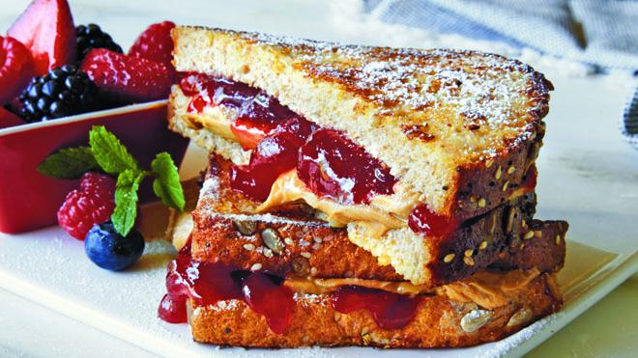

Slide 173
Is Even
def main():
for i in range(100):
if is_even(i):
print(i)

Slide 174
Boolean Return
def main():
for i in range(100):
if is_even(i):
print(i)
def is_even(x):
if x % 2 == 0:
return True
else:
return False

Slide 175
Boolean Return
def main():
for i in range(100):
if is_even(i):
print(i)
def is_even(x):
return x % 2 == 0

Slide 176
Is Divisible By 7
def main():
for i in range(100):
if is_divisible_by(i, 7):
print(i)

Slide 177
Boolean Return
def main():
for i in range(100):
if is_divisible_by(i, 7):
print(i)
def is_divisible_by(num, divisor):
if num % divisor == 0:
return True
else:
return False

Slide 178
Boolean Return
def main():
for i in range(100):
if is_divisible_by(i, 7):
print(i)
def is_divisible_by(num, divisor):
return num % divisor == 0

Slide 179
Can a function return multiple values?
YES!

Slide 180
Multiple Return Values
def max(num1, num2):
if num1 >= num2:
return num1
return num2
terminal
> python3 maxmax.py
5 is bigger.
def main():
larger = max(5, 1)
print(str(larger) + ” is bigger.”)

Slide 181
Multiple Return Values
def order(num1, num2):
if num1 >= num2:
return num1, num2
return num2, num1
terminal
> python3 maxmax.py
1 is smaller than 5
def main():
smaller, larger = order(5, 1)
print(str(smaller) + “ is smaller than “ + str(larger))

Slide 182
Lecture Plan
Functions: From Karel to Python
Example: Factorial
More About Functions
Example: Graphics

Slide 183
Learn How To:
Write a function that takes in input
Write a function that gives back output
Trace function calls using stacks

Slide 184

Bonus Exercise
Greek mathematicians took a special interest in numbers that are equal to the sum of their proper divisors (a proper divisor of n is any divisor less than n itself). They called such numbers perfect numbers. For example, 6 is a perfect number because it is the sum of 1, 2, and 3, which are the integers less than 6 that divide evenly into 6. Similarly, 28 is a perfect number because it is the sum of 1, 2, 4, 7, and 14.
Design and implement a Python program that finds all the perfect numbers between two limits. For example, if the limits are 1 and 10000, the output should look like this:
FindPerfect
The perfect numbers between 1 and 10000 are:
6
28
496
8128

